Slide 1
VM450 Design and Manufacturing III
&
VE450 Major Design Experience
&
VG450 Global MDP
Course Overview
Notes:
VM467 - Introduction to Robotics UM-SJTU Joint Institute, Shanghai Jiao Tong University Copyright 2009. Kai Xu. All Rights Reserved

Slide 2


VM/VE/VG 450
Notes:
VM467 - Introduction to Robotics UM-SJTU Joint Institute, Shanghai Jiao Tong University Copyright 2009. Kai Xu. All Rights Reserved

Slide 3
Course Philosophy
The educational goal of VM/VE/VG450 is to:
  Simulate a real-world working environment,
  Give each student a deep understanding of how to approach open ended challenges by process
  Teach how to innovate and apply the seemingly fragmented engineering knowledge acquired at JI to the design and implement of real mechanical, mechatronic, information or electrical/computer systems.
Notes:
VM467 - Introduction to Robotics UM-SJTU Joint Institute, Shanghai Jiao Tong University Copyright 2009. Kai Xu. All Rights Reserved

Slide 4

VM/VE/VG450
Course coordinator
  Coordinate project proposals, design reviews, report grading, final expo, etc.
  Prof. Mian LI and Chengbin MA
Course instructor
  Meet his/her teams weekly, checking progresses as well as ensuring proper design philosophy being practiced
  Prof. Yong LONG and Yunlong GUO
Project sponsor
  Meet his/her teams weekly, providing
  technical supports
  SJTU/JI faculty members or company mangers
Notes:
VM467 - Introduction to Robotics UM-SJTU Joint Institute, Shanghai Jiao Tong University Copyright 2009. Kai Xu. All Rights Reserved

Slide 5

Textbooks
Reference textbook
  George Dieter and Linda Schmidt, Engineering Design,
  5th Ed., 2012, McGraw Hill.
  Due to the variety of Capstone projects, there are other materials necessary available online or from sponsors
Notes:
VM467 - Introduction to Robotics UM-SJTU Joint Institute, Shanghai Jiao Tong University Copyright 2009. Kai Xu. All Rights Reserved

Slide 6
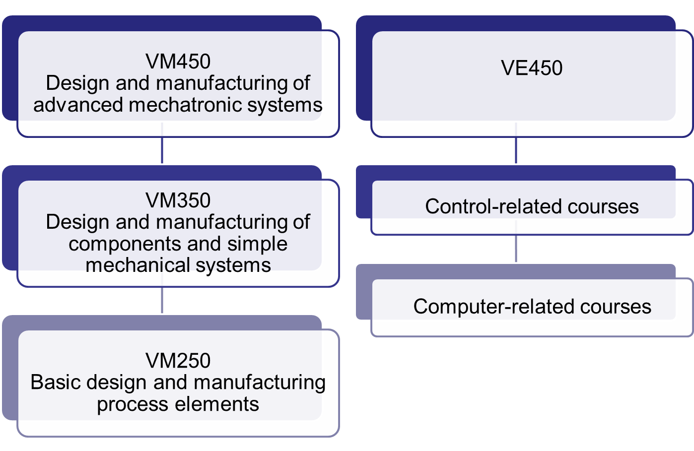
How We Get Here
Electronics-related courses
Notes:
VM467 - Introduction to Robotics UM-SJTU Joint Institute, Shanghai Jiao Tong University Copyright 2009. Kai Xu. All Rights Reserved

Slide 7
Course Concept
To provide hands-on engineering design experience to engineering student teams by solving real-world design and manufacturing problems.
Students work in a team environment to
  Identify a need
  Propose concepts
  Make a selection based on quantitative analysis
  Prototype for testing
  Communicate with sponsors in a professional way
    Business dress code will be required for important activities.
Notes:
VM467 - Introduction to Robotics UM-SJTU Joint Institute, Shanghai Jiao Tong University Copyright 2009. Kai Xu. All Rights Reserved

Slide 8
Design Reviews
3 design reviews + Expo
  DR #1: Engineering specifications, Oct 14
  DR #2: Concepts selection, Oct 30
  DR #3: Final detailed design, Nov 20
  Final: Final expo, Dec 11
  VG450’s requirements are different from above
Communication in a professional way
  Business dress code will be required
    Kick-off meetings
    Design reviews and Design Expo
    Corporate Projects Final Delivery
Notes:
VM467 - Introduction to Robotics UM-SJTU Joint Institute, Shanghai Jiao Tong University Copyright 2009. Kai Xu. All Rights Reserved

Slide 9
Let us work hard and stick to the honor code!
Notes:
VM467 - Introduction to Robotics UM-SJTU Joint Institute, Shanghai Jiao Tong University Copyright 2009. Kai Xu. All Rights Reserved

Slide 10
What teach “Design”?
People have been designing for over 5000 years…
  Haven’t we figured out how to do this right yet?
There is a continuous need in society for new cost-effective, high-quality products.
  The target is moving!
It has been said that 85% of current products:
  Do not work as well as they should
  Take too long to bring to market
  Cost too much
  Have excessive environmental impact, etc. (Ullman, 1992)
Notes:
VM467 - Introduction to Robotics UM-SJTU Joint Institute, Shanghai Jiao Tong University Copyright 2009. Kai Xu. All Rights Reserved

Slide 11
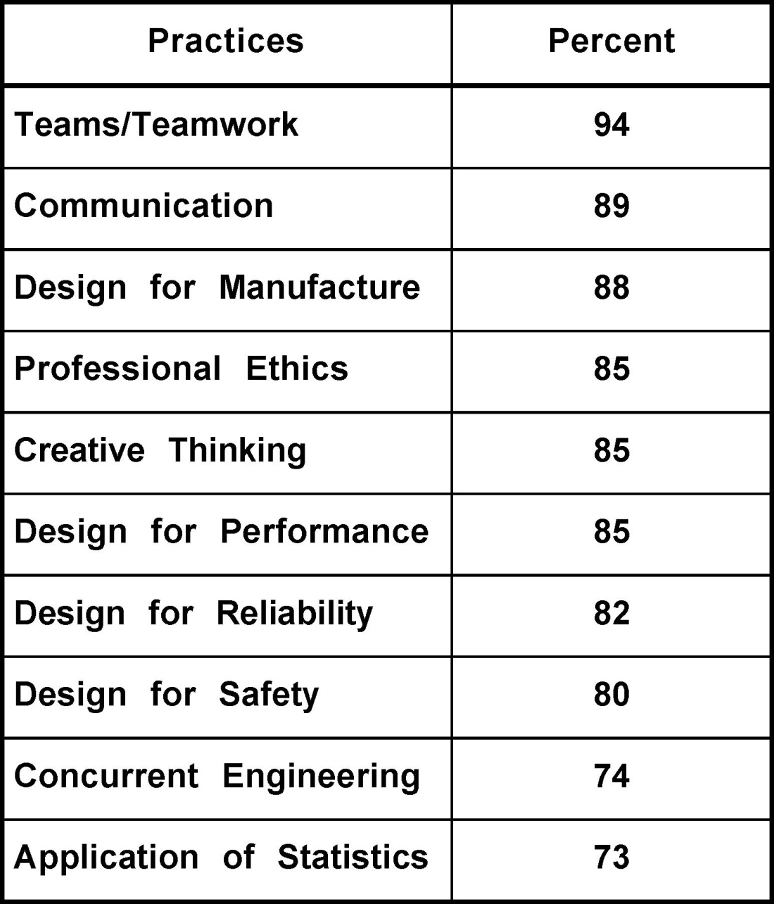

Industry Perspective
What Emerging Engineers Need to Know:
Valenti, M. “Teaching Tomorrow’s Engineers” July 1996, Mechanical Engineering
Notes:
VM467 - Introduction to Robotics UM-SJTU Joint Institute, Shanghai Jiao Tong University Copyright 2009. Kai Xu. All Rights Reserved

Slide 12

A Bridge Course
Team-based
Project-based
Design
Prototype
Make the initial contact with engineers in industry
Learn from mentors
Notes:
VM467 - Introduction to Robotics UM-SJTU Joint Institute, Shanghai Jiao Tong University Copyright 2009. Kai Xu. All Rights Reserved

Slide 13
The Ideal Project
Innovative
  Projects should allow for multiple solution ideas. Sponsors should provide all relevant information, but avoid imposing a solution.
Unique
  Students do well on new products, one-off manufacturing systems, or mature products where new ideas may make possible a breakthrough.
Decomposable
  The best projects can be approached in pieces.
Physical
  Paper studies are not acceptable; projects leading “physical” prototypes are required.
Notes:
VM467 - Introduction to Robotics UM-SJTU Joint Institute, Shanghai Jiao Tong University Copyright 2009. Kai Xu. All Rights Reserved

Slide 14
Thank you

